Slide 1
Sexual Violence Prevention at Canisius College
January 12, 2016
Terri L. Mangione, PhD
Vice President for Student Affairs/Title IX Coordinator

Slide 2
National Data
Some research suggests that 1 in 5 college women are subjected to attempted or completed sexual assault
90% of sexual assaults are committed by someone the victim knew
75% of sexual assaults involve the use of alcohol

Slide 3
Key Legislation
Jeanne Clery Act and reporting
VAWA Amendments to Clery
Campus SaVE Act (The Campus Sexual Violence Elimination Act of 2013)
Enough is Enough – NYS Legislation

Slide 4
Jeanne Clery Act Requirements
Annual security report
Effective October 1, 2015 must report all incidences of sexual violence
Fines from US Department of Education for failure to comply

Slide 5
Violence Against Women Act VAWA 1994
Established federal legal definitions of domestic violence, dating violence, sexual assault, and stalking.

Slide 6
Campus SaVE Act
Campuses must educate all members of their community on the prevention of rape, acquaintance rape, domestic violence, dating violence, sexual assault, and stalking.
Amended VAWA and the Clery Act

Slide 7
NYS Enough is Enough October 2015
Student Bill of Rights – Sexual Assault
Definition of Consent
Confidential support and privacy in reporting
New amnesty policy
New hearing panel process
New hearing panel appeals process
Transcript notation

Slide 8
Education and awareness at Canisius for new students
On-line education prior to arrival and additional refreshers.
Separate educational programs at orientation for students and parents.
Bystander intervention program in weeks 2-4 of first semester.
Assessment of new programs.

Slide 9
Education and awareness at Canisius for continuing students
Initial and on-going training for Resident Assistance, Hall Directors, Orientation Leaders, tutors, on new legislation and reporting options/support.
“Consent” and Community Standards educational program for all student leaders and intercollegiate student-athletes.
Sexual Violence Prevention Month programming every April.

Slide 10
Education and awareness at Canisius for faculty/staff
Initial and on-going training for all athletic department staff and coaching staff.
Initial and on-going training for counseling center, health services staff, and public safety officers.
New mandatory on-line training program for all faculty and staff.

Slide 11
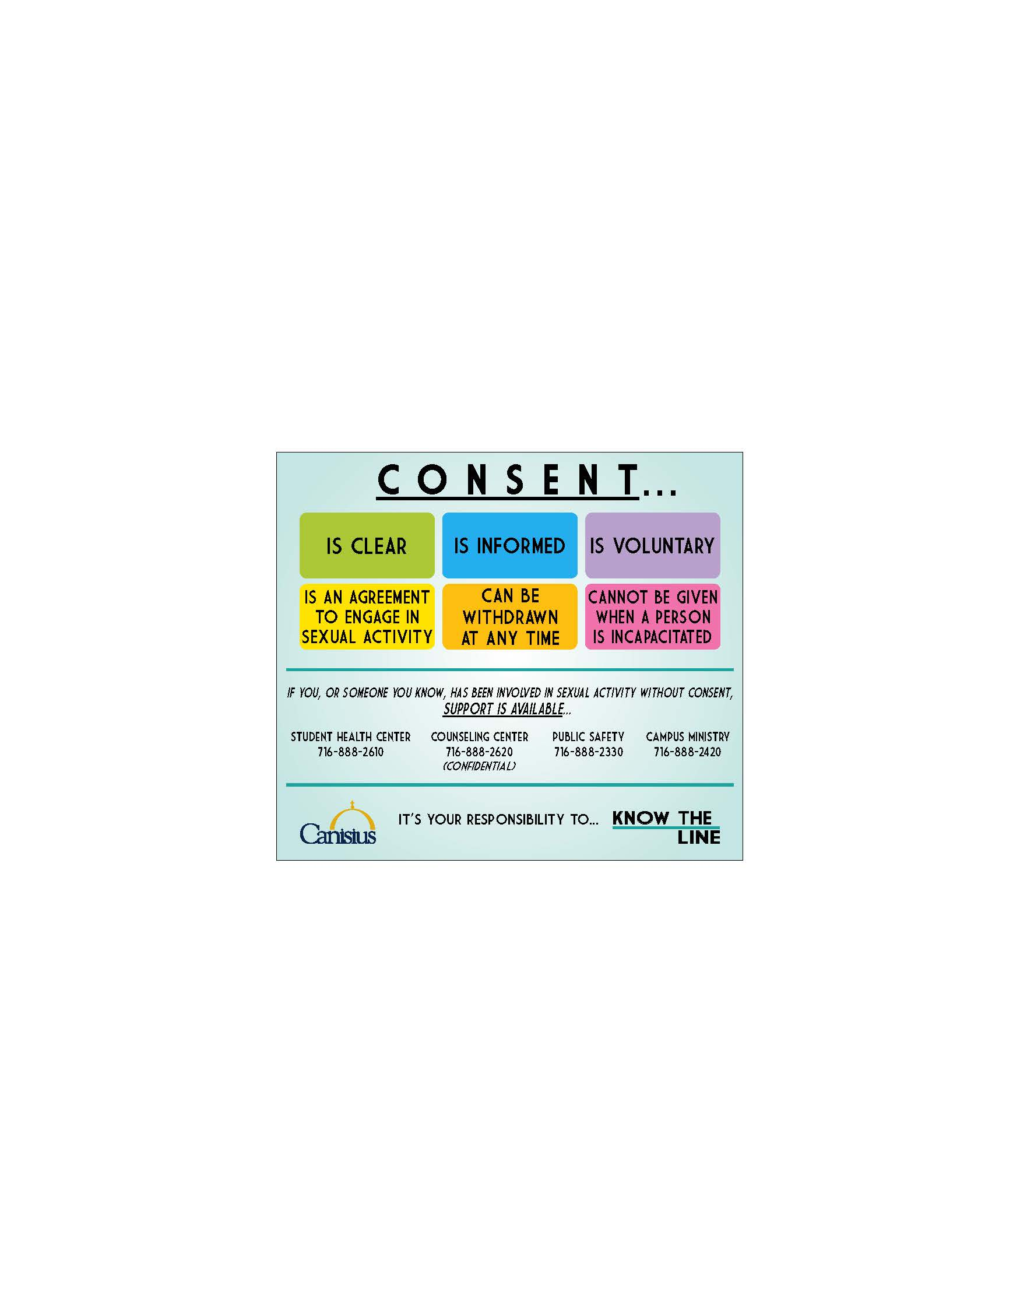
Defining Consent

Slide 12
Understanding consent
https://www.youtube.com/watch?v=fGoWLWS4-kU

